Slide 1
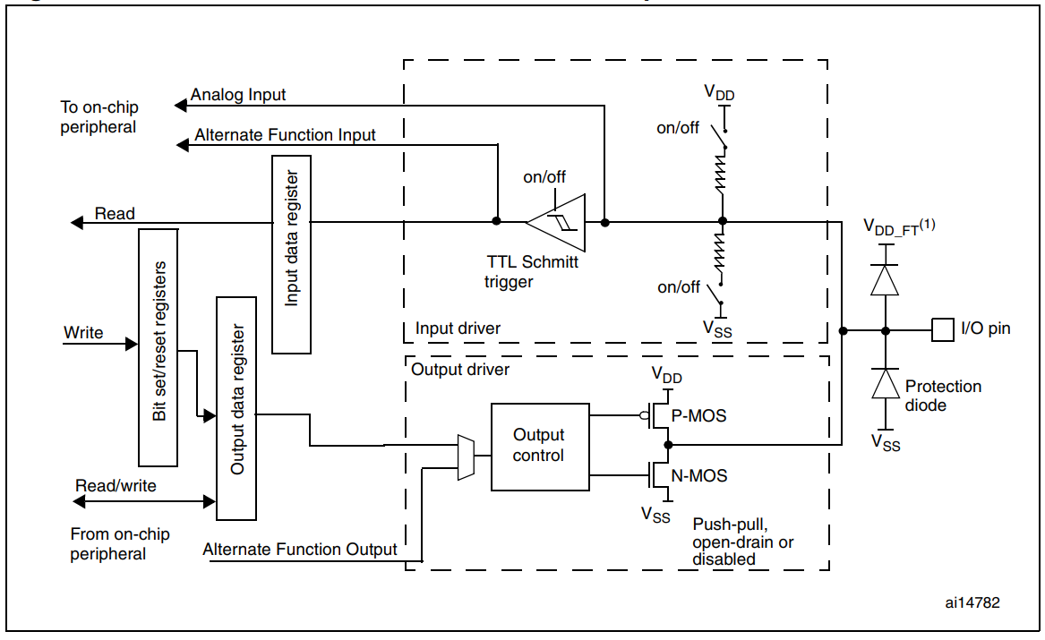
0
0
1

Slide 2
